Slide 1


IMPROVED CONVOLUTIONAL NEURAL NETWORK BASED ON GUIDED FILTER FOR GLAUCOMA DETECTION
SEMESTER 7
NOV 19 , 2022
7 ECE 1 - B

Slide 2
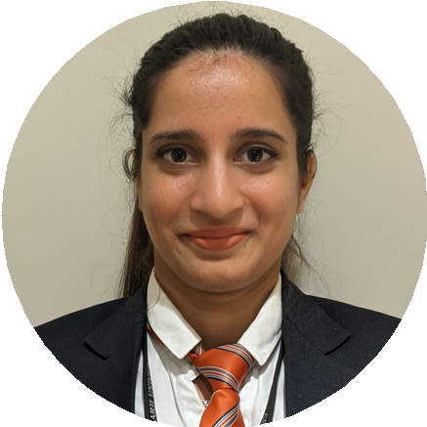

Team Description
MENTOR
Rishali Rishu
LEADER
19 BEC 1102
PROBLEM
IDENTIFICATION | FRAMEWORK
Sushant kumar
DR. Sonali Dash
19 BEC 1078 VALIDATED SOLUTION
PROFESSOR
ELECTRONICS AND COMMUNICATION ENGINEERING
UIE, CU

Slide 3
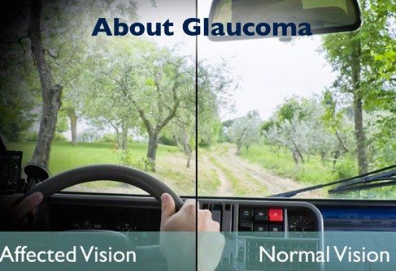
Problem Statement
Glaucoma is a group of eye conditions that damage the optic nerve. The optic nerve sends visual information from your eye to your brain and is vital for good vision. Damage to the optic nerve is often related to high pressure in your eye. But glaucoma can happen even with normal eye pressure
With Vision At stake it becomes necessary to detect it timely

Slide 4
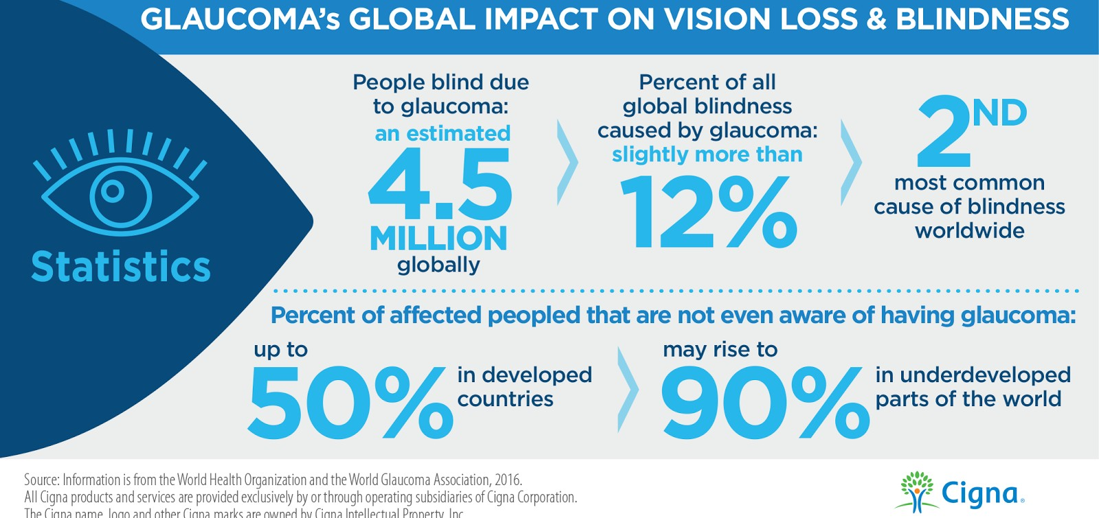
Statistics

Slide 5
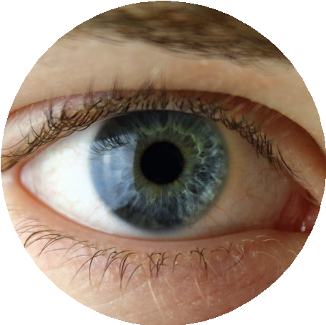





Objectives
There are numerous ways to identify glaucoma, including tonometry, A visual assessment technique that can identify glaucoma is cup-to- disc ratio. Using image processing methods like binarization the cup-to-disc ratio is calculated in this project and utilized to assess the glaucomatous status of an eye using classification.
Vision
Preservation
Automated
ZERO COST
Accurate

Slide 6





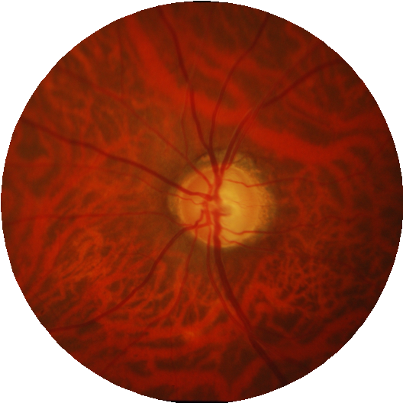

Methodology
Improved Convolutional neural
network Based on Guided f i lter for Glaucoma Detection

Slide 7
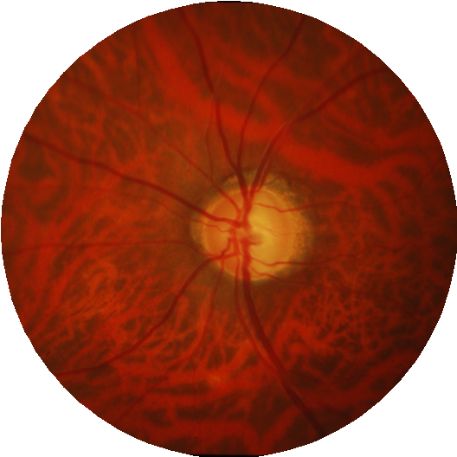


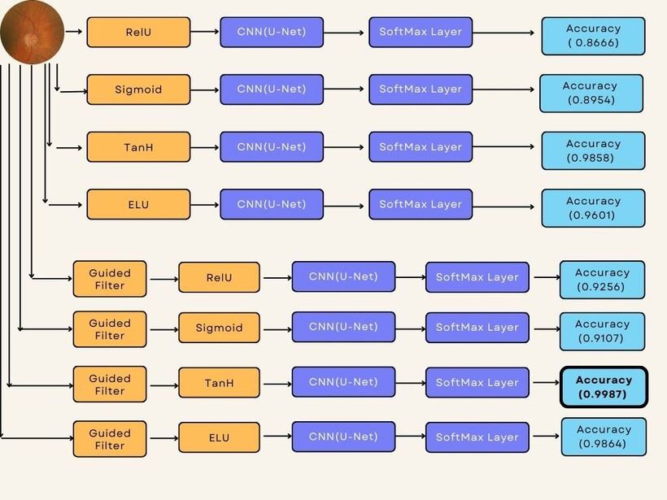


Proposed Solution
Fundus Image
Preprocessing
A c curacy
50
CNN( U- Net)
40
30
20
10
Feature Extraction
0
Item 1 Item 2 Item 3 Item 4 Item 5

Slide 8


FRAMEWORK
Kaggle
Kaggle allows users to find and publish data sets, explore and build models in a web-based data-science environment, work with other data scientists and machine learning engineers, and enter competitions to solve data science challenges.
PYTHON LIBRARIES
A Python library is a reusable chunk of code that you may want to include in your programs/ projects. Compared to languages like C++ or C, Python libraries do not pertain to any specific context in Python. Here, a 'library' loosely describes a collection of core modules.

Slide 9
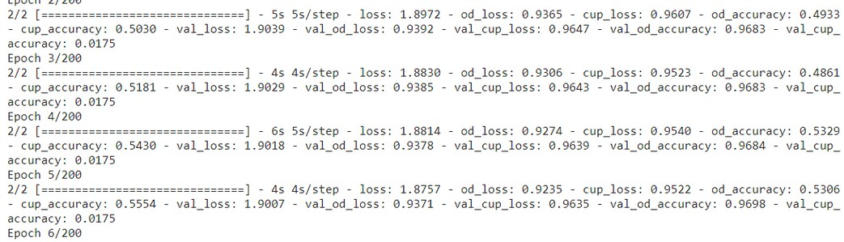
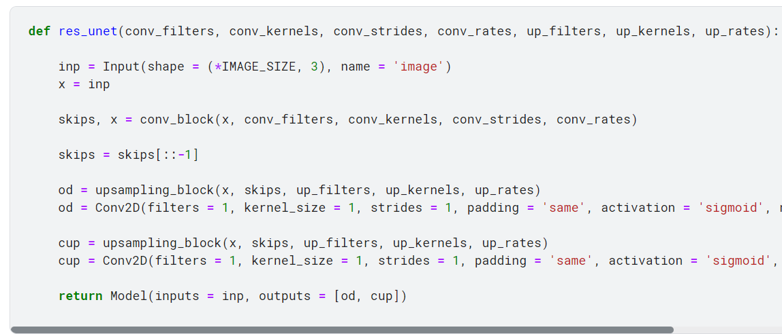
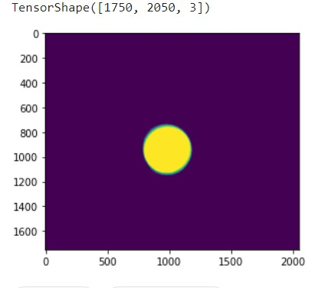
PROGRESSIVE PICTURES OF PROJECT

Slide 10
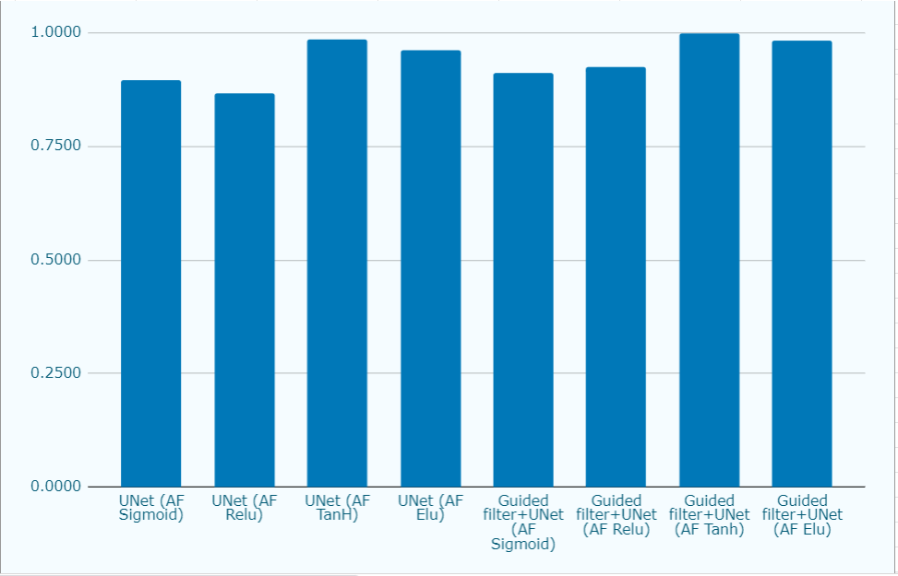
Results and Discussion

Slide 11

Conclusion
The Suggested Method for classification utilizes U- Net for feature extraction but unlike the original network we utilized different Activation function and added a Guided filter for the images within the dataset
So the suggested method outperforms the original UNet network.

Slide 12
THANK YOU !

